Slide 1
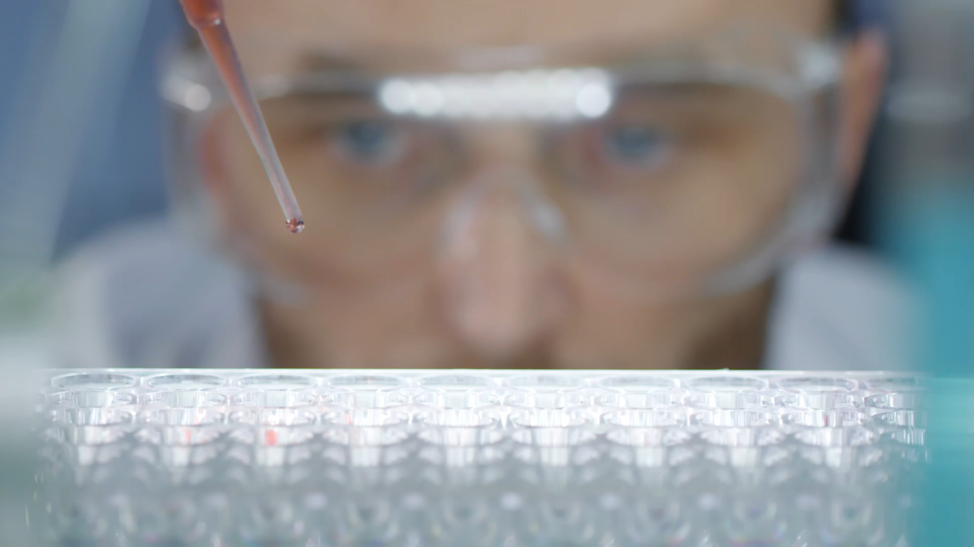
red blood celLS (RBC) counting code via imaging tools
Subject: Scientific Python
Professor: Dr. Goda Márton Áron
Student: Atymtay Shynar

Slide 2
Imaging and Microscopy
Very useful for biologist to acquire skills in
For learning purposes I aimed:
simple and understandable code that I will be able to do,
to understand and make progress in learning Python.
Though I will still need further practice

Slide 3
Goals:
To be able to contour round cells in the chosen image;
To count contoured cells and give the output in numbers;
To be able to implement these stages for any other microscopy images in the future
Tools:
-CV2 package;
-Matplot package;
-Numpy package

Slide 4
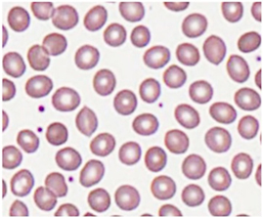
Original Image to process:

Slide 5
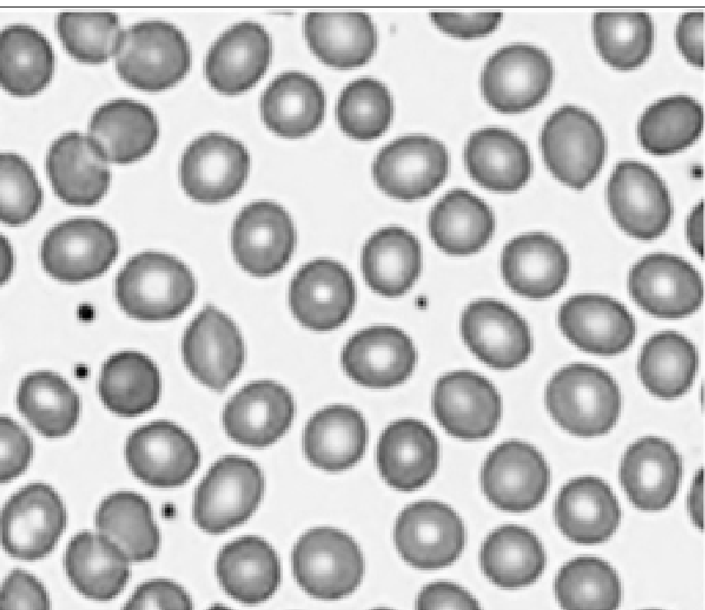
Opening and turning grey:
# first we need to download packages import cv2 import numpy as np import matplotlib.pyplot as plt
#opening using cv2 RBC= cv2.imread('RBC.jpg’)
#turning into gray via cv2 cvtcolor gray = cv2.cvtColor(RBC, cv2.COLOR_BGR2GRAY) plt.imshow(gray, cmap='gray');

Slide 6
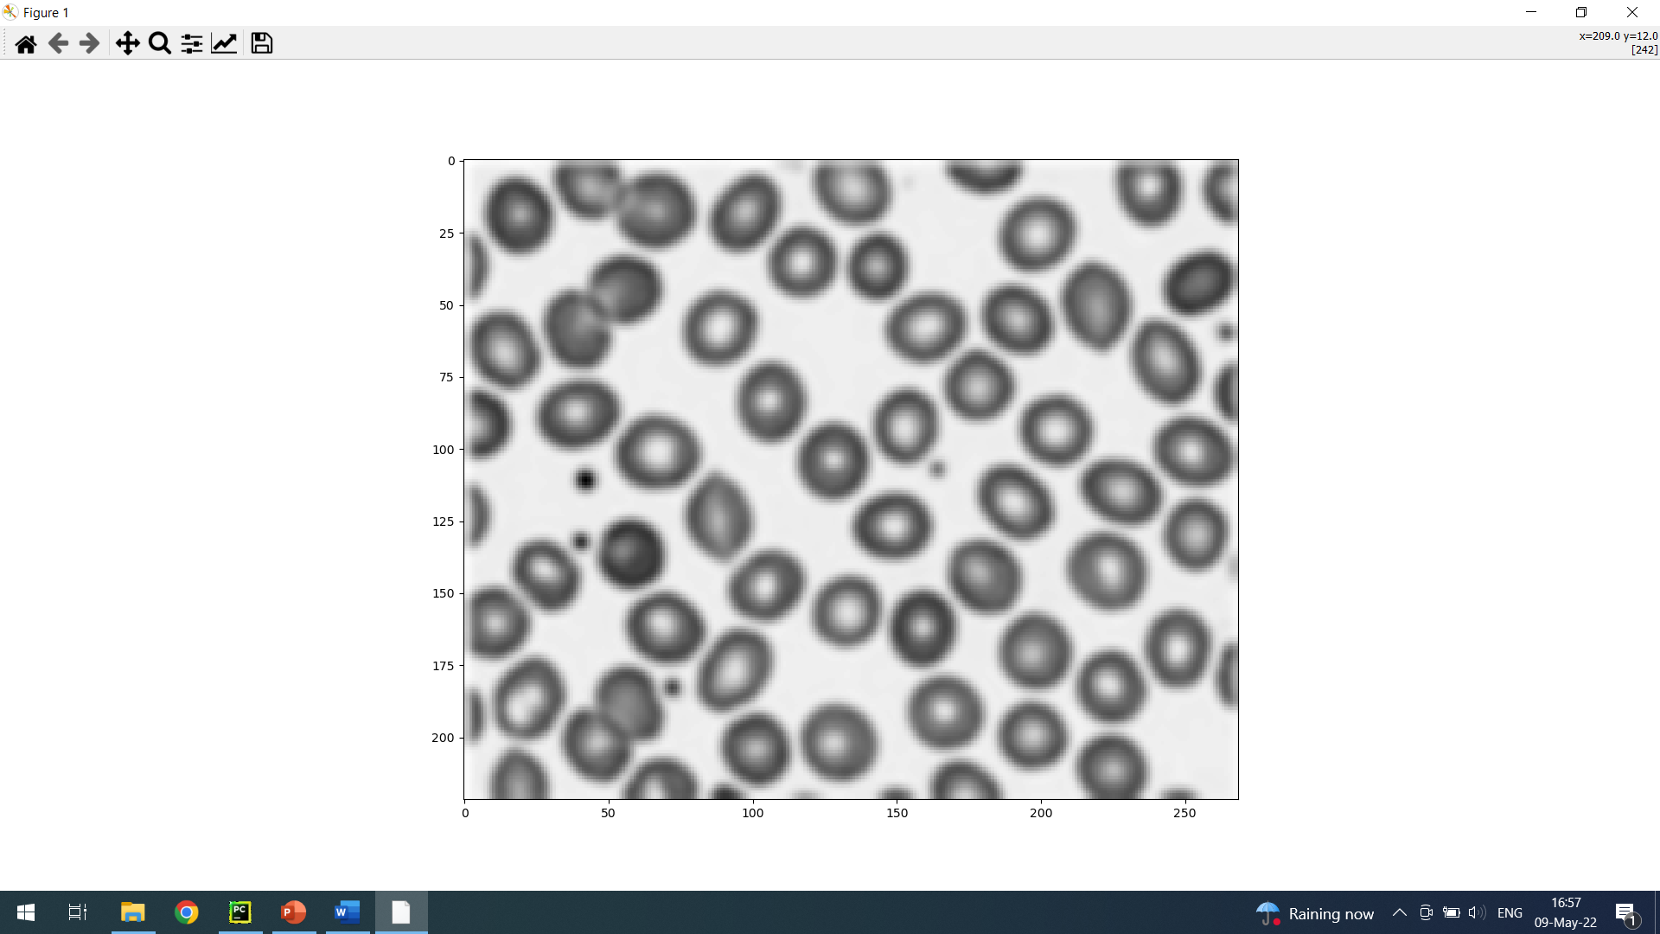
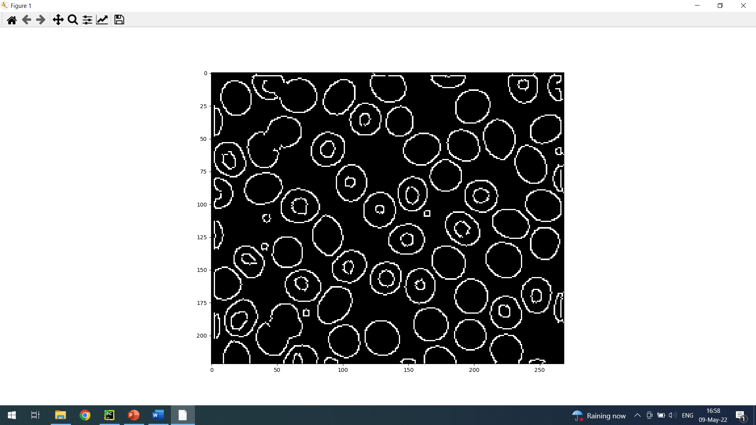
Blurring and Contouring:
#in order to detect cells, we need to turn image into blur, this way we can avoid the noise around #the 9 to 9 is kernel, that hover over whole picture, 0 is stdv #the more you increase the size of kernel the more blured image becomes
#I used Gaussianblur method here
Gaussianblur = cv2.GaussianBlur(gray, (9,9), 0) plt.imshow(Gaussianblur, cmap='gray'); #for detecting the edges Cany edge algorithm can be used in this case # the blurred image should be used to avoid the noise around the desired round circles #the 3 number is default, it is for finding edges #lower and upper values are set to identify the edges, we can adjust it for our picture
contour = cv2.Canny(Gaussianblur, 70, 160, 3) plt.imshow(contour, cmap='gray')

Slide 7
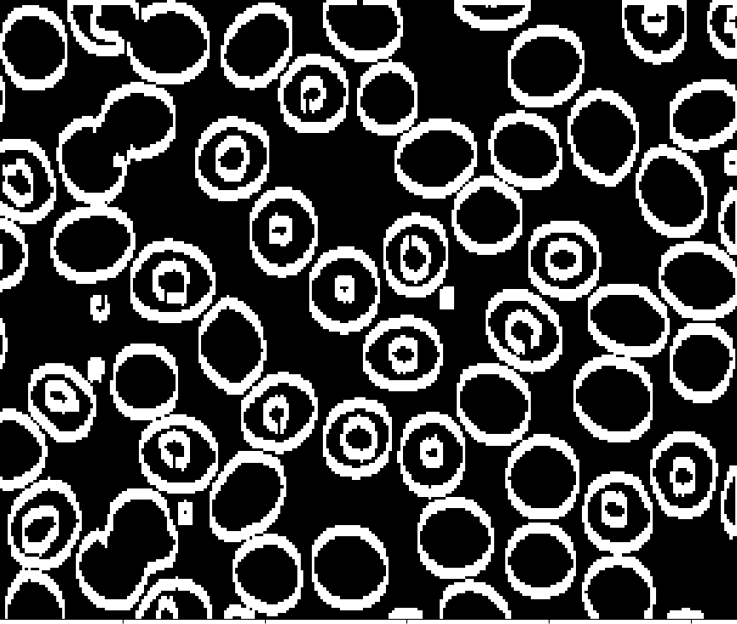
Dilation of contours and counting :
#this can be used to have finished closed edges contour #the more iterations are made the thicker are the contours str_con= cv2.dilate(contour, (1,1), iterations = 3) plt.imshow(str_con, cmap='gray') #counting #cv2.retr_external means counting only external edges #cv2.chain_approx_none considering all contours (cnt, heirarchy) = cv2.findContours(str_con.copy(), cv2.RETR_EXTERNAL, cv2.CHAIN_APPROX_NONE)

Slide 8
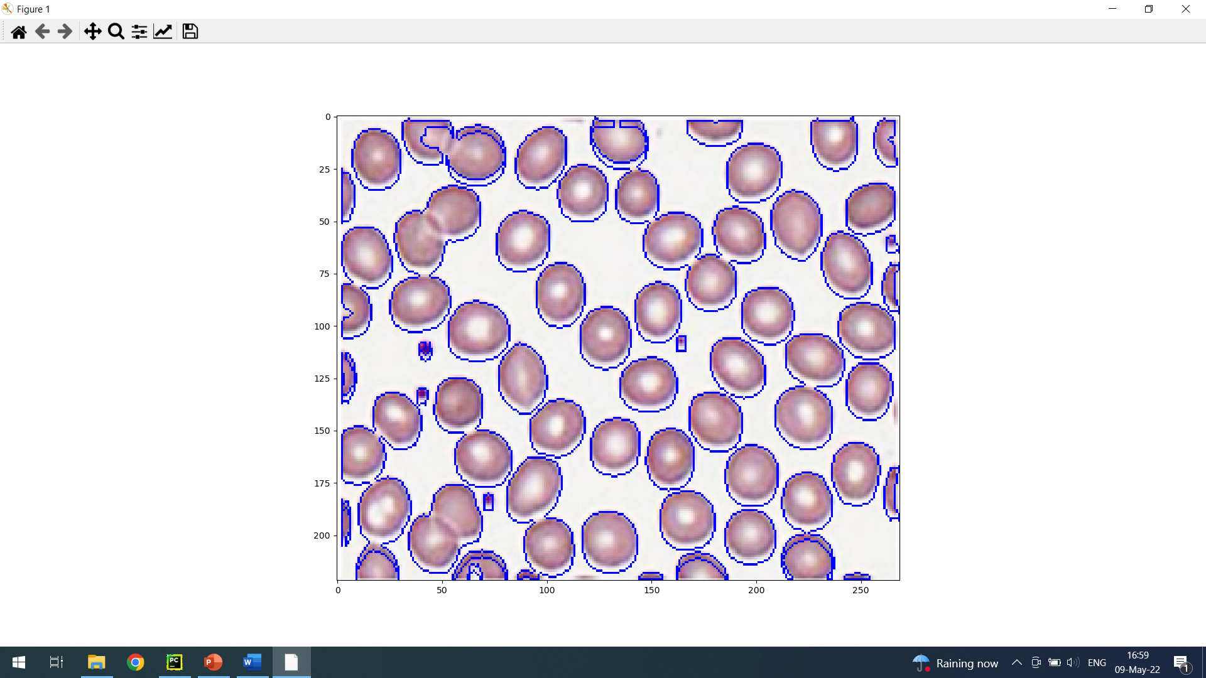
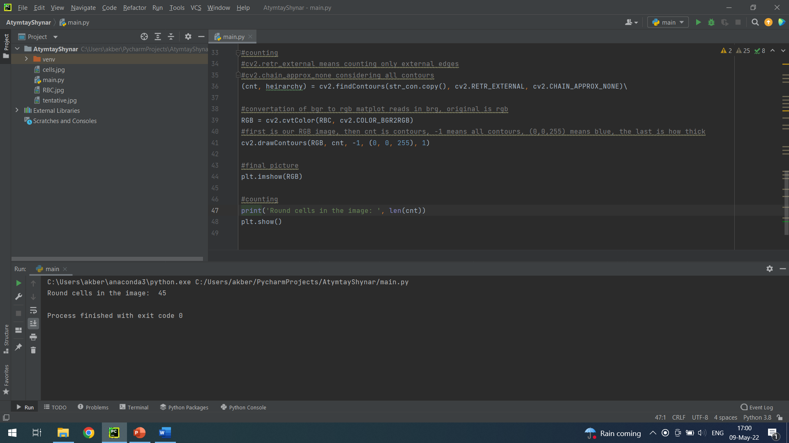
Labelling original Image with blue and displaying the counted cells:
# I wanted to contour cells with blue on original image #convertation of bgr to rgb matplot reads in brg, original is rgb RGB = cv2.cvtColor(RBC, cv2.COLOR_BGR2RGB)
#first is our RGB image, then cnt is contours, -1 means all contours, (0,0,255) means blue, the last is how thick is the line cv2.drawContours(RGB, cnt, -1, (0, 0, 255), 1) #final picture plt.imshow(RGB) #displaying print('Round cells in the image: ', len(cnt)) plt.show()

Slide 9
Thank you for attention! Good luck in preparations

